Slide 1
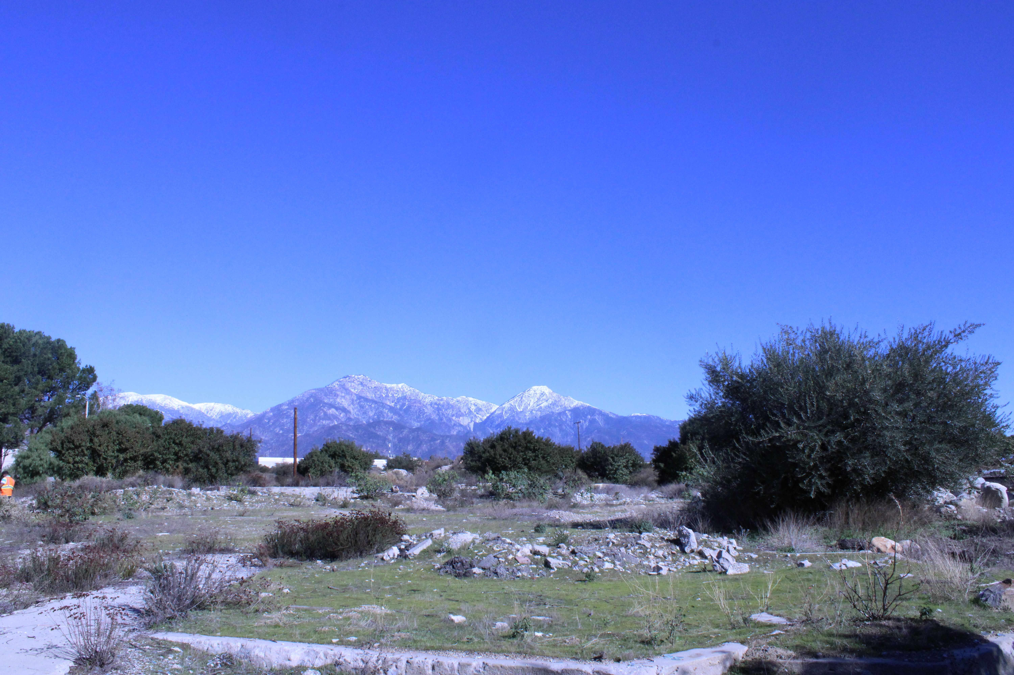
IST303 Fall 2022
The Dream Team
Hunter Sayre
Javier Aguilar
Katie Enns
Pankaj Chaudhari
“claremont-presents.com”
Milestone 1 Presentation
Notes:
Add Date?

Slide 2

Presentation Outline
1) Iterations and Milestone Logic
2) Current Development Status
3) Coding Architecture &
User Story Demonstration
4) Code Testing
5) Milestone 2 and Remaining Work
Notes:
Divide into 4 parts
1) how we come up with iterations to fufill requirements
2) whats our current status – burnchart etc what we completed so far
3) more technical details codebase because outside of notebooks & application architecture
4) explain working code and code-testing and iteration 2
5) demo

Slide 3
Milestone 1:
1)
Development Motivations & Logic
Iteration 2 (4 weeks)
Add search widget in web application so that user can search area of interest.
Explore the various HTML frameworks for web responsive design and implemented it in website/application.
Give an option for user to change website/application settings.
Design the widget in web application with appropriate options for user to select categories.
Integrate the YELP’s search API with above widget to query results based on user selection.
Display all search results on map and zoom the map to search results.
Iteration 1 (2 weeks)
Create a Skeleton web application with default base-map.
Explore the various types of base-map options available and create widget for user to pick appropriate base-map.
Explore the YELP search API and figure out best way to integrate it in web application.
Notes:
The reason the Dream Team decided this application should be created is because Claremont is a part of all our day-to-day lives through CGU, so it is practical to want to know the Claremont area better as to be able to enjoy everything it has to offer
Iteration 1 we focused on the critical tasks to achieve a basic functionality for our application
As such we gave 2 weeks as there are fewer but more important tasks
Iteration 2 was alotted 4 weeks so we can refine the application and provide more user functionalities

Slide 4


People want…
1)
…To be able to see a website which has map on home page, and it's zoom to Claremont city by default and have ability to search required location.
…The website to be responsive. It must be rendered properly on desktop and mobile devices properly.
…To be able to move around the map (zoom in and out) and see different types of maps and change settings of website/application to see it in different themes.
…Select specific categories and related multiple subcategories. User wants to able to specify the radius within which specific categories can be located. Application must use YELP search API in backend to query the information related to categories of interest.
…To browse through all search results on map and shall be able to retrieve more information by clicking on specific search result on map.
…To see additional information like rating, distance etc. for all search results from specified search location.
Admin user wants to be able to login into website to view admin dashboard.
Admin user wants to know which filters are selected most often to better understand how users are interacting with the app
Development Overview
2 Milestones
8 User Stories
17 Tasks
Notes:
Should we reflect changing User Stories as the app has been developed or keep the originally planned User Stories – Eg, what have we been able to do
Why did we choose these user stories, give information in notes

Slide 5
Milestone 1 - Iteration 1 Features
1)
Responsive Web application with ability for users to search required location, pick base-map of their choice and change the application settings.
Fully integrated YELP's Search API to query and display the search results on map.
Designed backend database to store information related to usage of website/application.
Notes:
#Are we still including these Iteration Slides, considering we see user stories elsewhere
# remove python,flask,yelp move elsewhere

Slide 6
Milestone 1 - Iteration 2 Features
1)
Add search widget in web application so that user can search area if interest.
1
Explore the various HTML frameworks for web responsive design and implemented it in website/application.
2
Give an option for user to change website/application settings.
3
Design the widget in web application with appropriate options for user to select categories.
4
Integrate the YELP’s search API with above widget to query results based on user selection.
5
Display all search results on map and zoom the map to search results.
6

Slide 7
Development Status
2)
Link to our Github:
https://github.com/katieenns/Dream-Team
Link to our Issues:
https://github.com/katieenns/Dream-Team/issues
Link to our Project Dashboard:
https://github.com/users/katieenns/projects/1

Slide 8
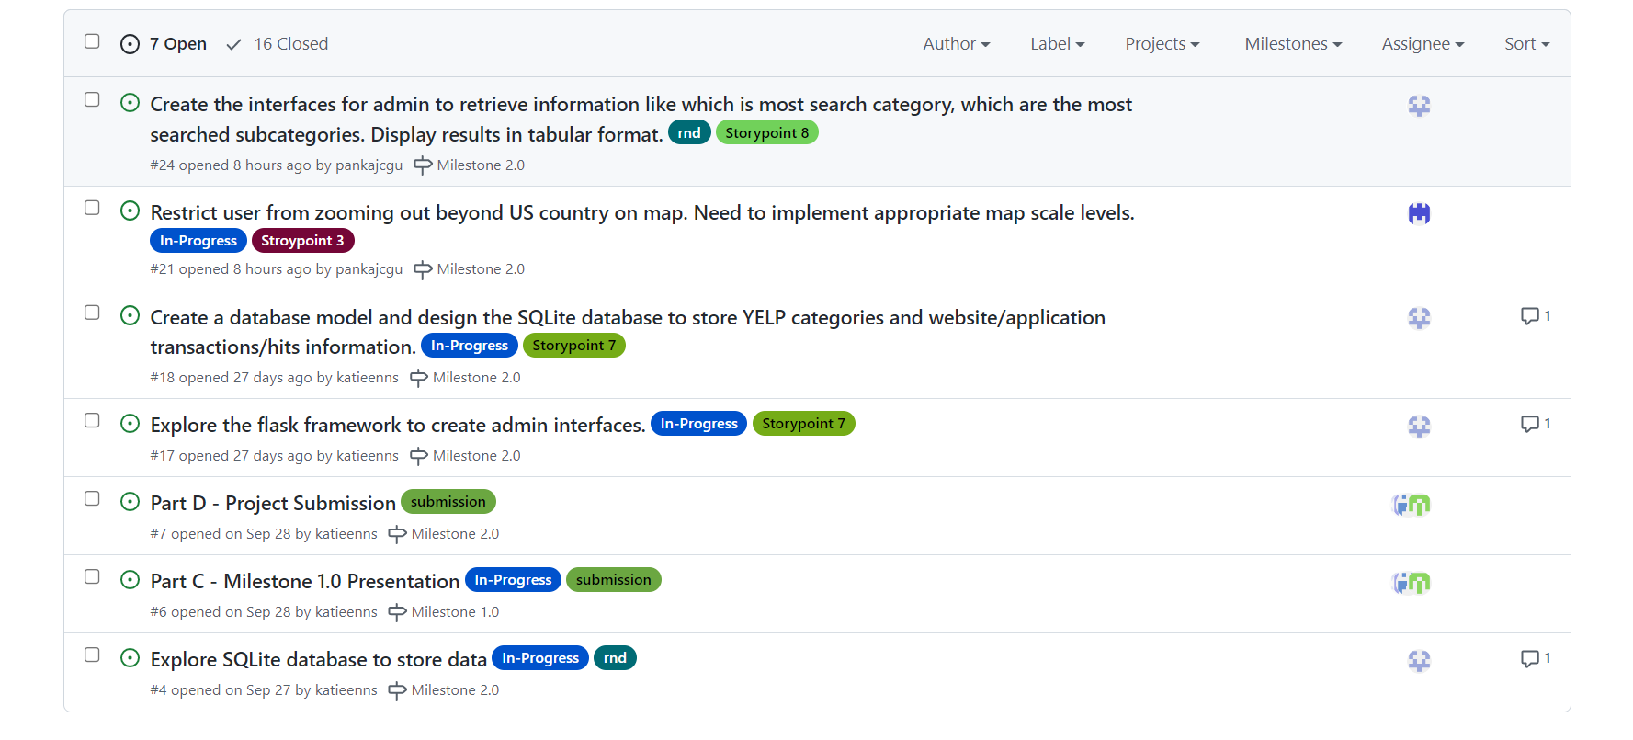
Development Status & Timeline
2)
7 Open
Project Issues
16 Closed
Notes:
our project management is proactive
We have labeled each issue to developer, can see completion status, type of issue, etc etc

Slide 9
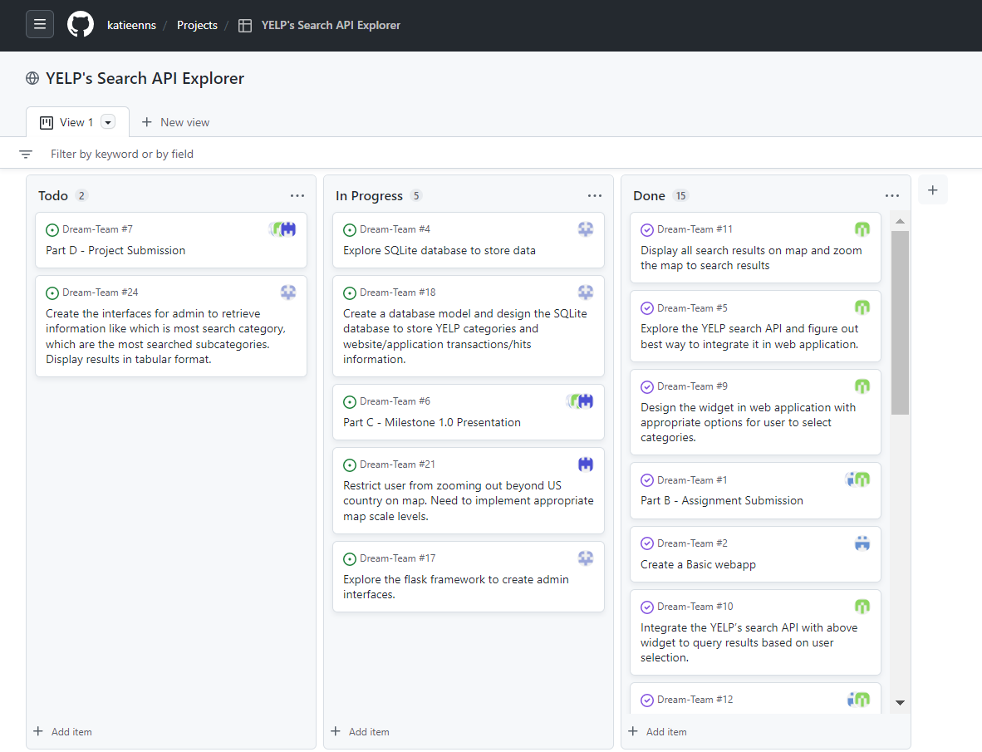
Development Status & Timeline
2)
Project Dashboard

Slide 10
Development Status
2)
Milestone 1 Statistics
12 of 17 total tasks completed.
6 of 8 user stories completed.
16 Issues Closed, 7 Remain Open.

Slide 11
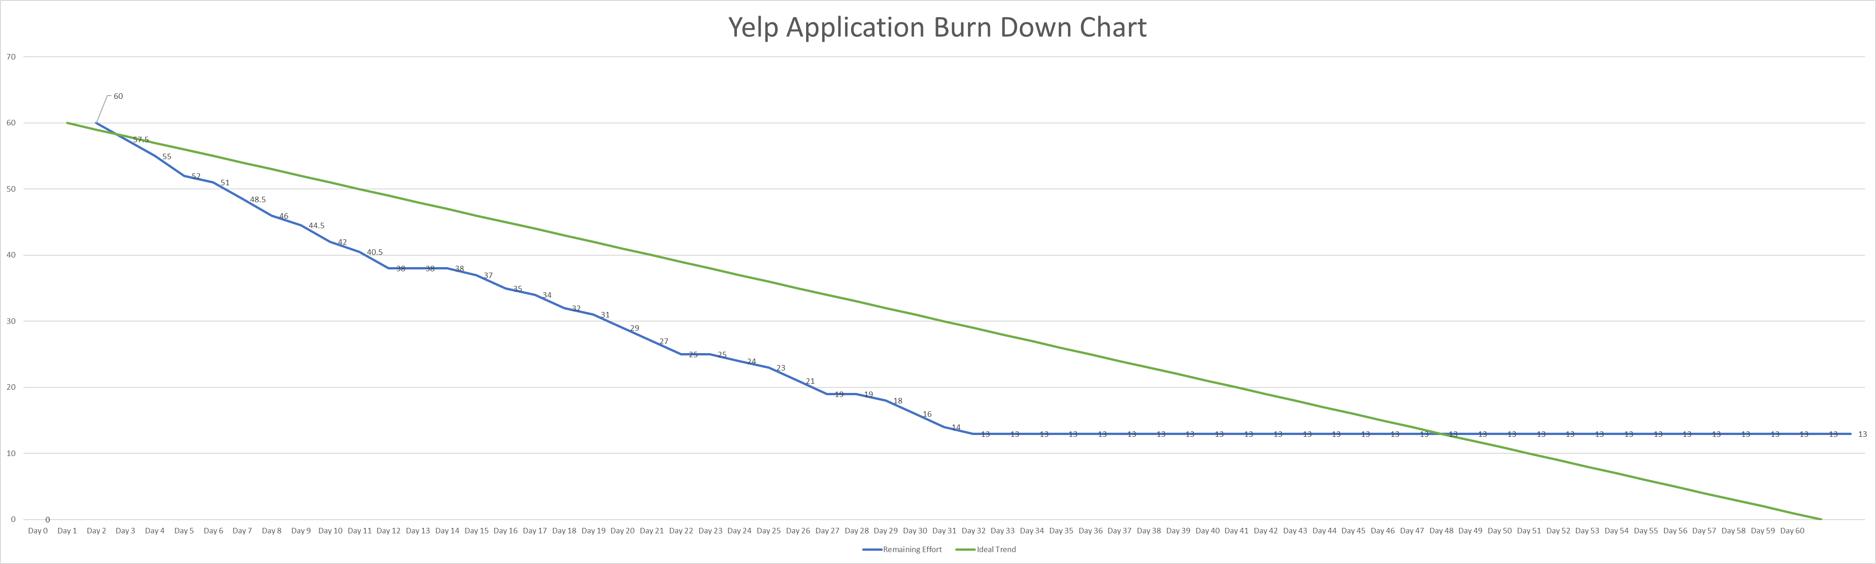
Milestone 1
2)
Development Status & Timeline
Milestone 2
60 Total Days Current Velocity 78% 2 Total Milestones 8 User Stories

Slide 12

Coding Architecture
3)
Core Application Modules
1) Yelp Module (core of project)
2) Website Framework
3) Map Module
4) Database Module

Slide 13





Technology Stack
3)
HTML, CSS (GUI Development)
Bootstrap (GUI Development)
Esri Calcite (GUI Development)
JavaScript (Frontend Scripting)
Esri ArcGIS JavaScript API (Frontend Scripting)
Flask (Web application framework)
Pytest (Unit testing)
API's
ArcGIS BaseMAP
ArcGIS Geocoding
YELP
SQLite (Filesystem database)

Slide 14
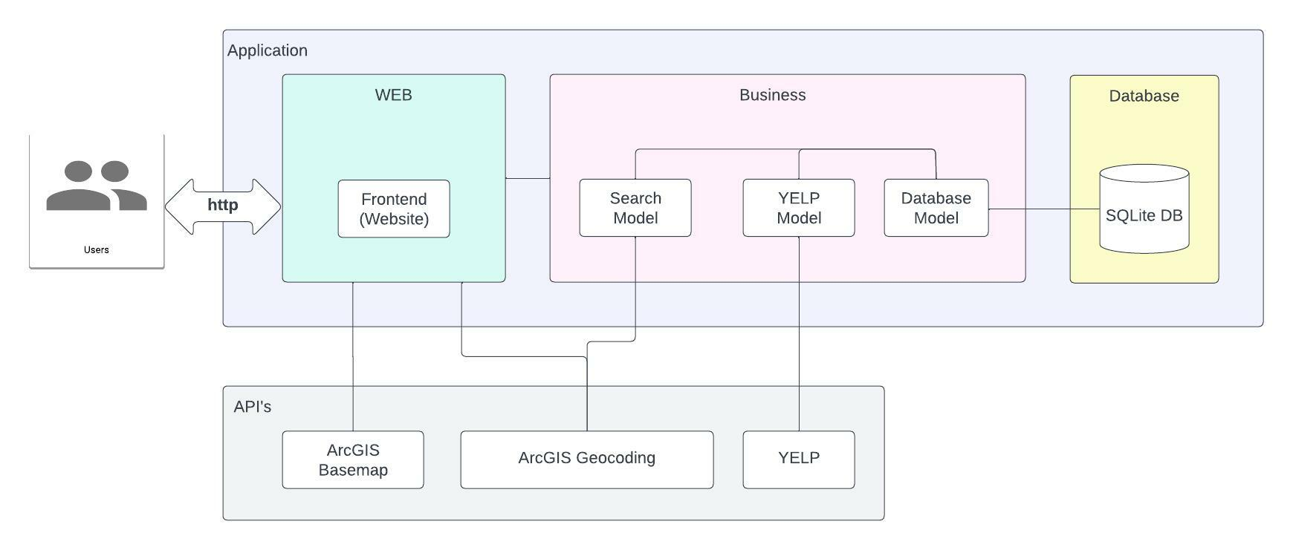
Application Architecture

Slide 15
Application Demonstration http://127.0.0.1:5000
3)
Notes:
Live Walk-Through of an example User Experience

Slide 16
People want…
1)
…To be able to see a website which has map on home page, and it's zoom to Claremont city by default and have ability to search required location.
…The website to be responsive. It must be rendered properly on desktop and mobile devices properly.
…To be able to move around the map (zoom in and out) and see different types of maps and change settings of website/application to see it in different themes.
…Select specific categories and related multiple subcategories. User wants to able to specify the radius within which specific categories can be located. Application must use YELP search API in backend to query the information related to categories of interest.
…To browse through all search results on map and shall be able to retrieve more information by clicking on specific search result on map.
…To see additional information like rating, distance etc. for all search results from specified search location.
Admin user wants to be able to login into website to view admin dashboard.
Admin user wants to know which filters are selected most often to better understand how users are interacting with the app
Development Overview
2 Milestones
8 User Stories
17 Tasks

Slide 17
How did we test this code to ensure User Story functionality?
4)
Story 1)
User wants to be able to see a website/application which has map on home page, and it's zoom to Claremont city by default and have ability to search required location.
Testing Strategy
Unit testing for base-map service
Unit testing for Geocoding Service
Manual testing for UI (Need to figure out a way to do automated testing)
Notes:
1) 3 things per slide; Logic
User Story 1 –
-Test Map Functionality
Write simple Unit Test to fire the URL and see the response code; if the response code is 200? We can tell map is live & working
-Test Search Functionality
Fire Unit Test, and it should return Claremont location, and should match the lat/long we have

Slide 18
Testing Continued…
4)
Story 2)
User wants the website/application to web responsive. It must be rendered properly on desktop and mobile devices properly.
Story 3)
User wants to be able to navigate/move around the map (zoom in and out) and see different types of maps and change settings of website/application to see it in different themes.
Testing Strategy
Manual testing for UI (Need to figure out a way to do automated testing)
Notes:
List 6 User Stories and for Each User Story we need to write the testing Strategy
Manual Testing for User Story 2 & 3– Need automation Framework in Milestone 2

Slide 19
Testing Continued…
4)
Story 4)
User wants to able to select specific category and related multiple subcategories. User wants to able to specify the radius within which specific categories can be located. Application must use YELP search API in backend to query the information related to categories of interest.
Testing Strategy
Unit testing for YELP API
Unit testing for retrieving YELP category information
Manual testing for UI (Need to figure out a way to do automated testing)
Notes:
List 6 User Stories and for Each User Story we need to write the testing Strategy
User Story 4– Need automation Framework in Milestone 2
-Unit Testing for Yelp API
-Unit Testing For Categories and Sub-Categories

Slide 20
Testing Continued…
4)
Story 5)
User want to able to browse through all search results on map and shall be able to retrieve more information by clicking on specific search result on map.
Story 6)
User wants to additional information like rating, distance etc. for all search results from specified search location.
Testing Strategy
Unit testing to test identify feature
Unit testing to check for additional information
Manual testing for UI (Need to figure out a way to do automated testing)
Notes:
List 6 User Stories and for Each User Story we need to write the testing Strategy
User Story 5 & 6
-Initial Unit Tests will return information
-Improve Testing for these stories 5 & 6 in Milestone 2, haven’t had time to reflect on testing strategies

Slide 21
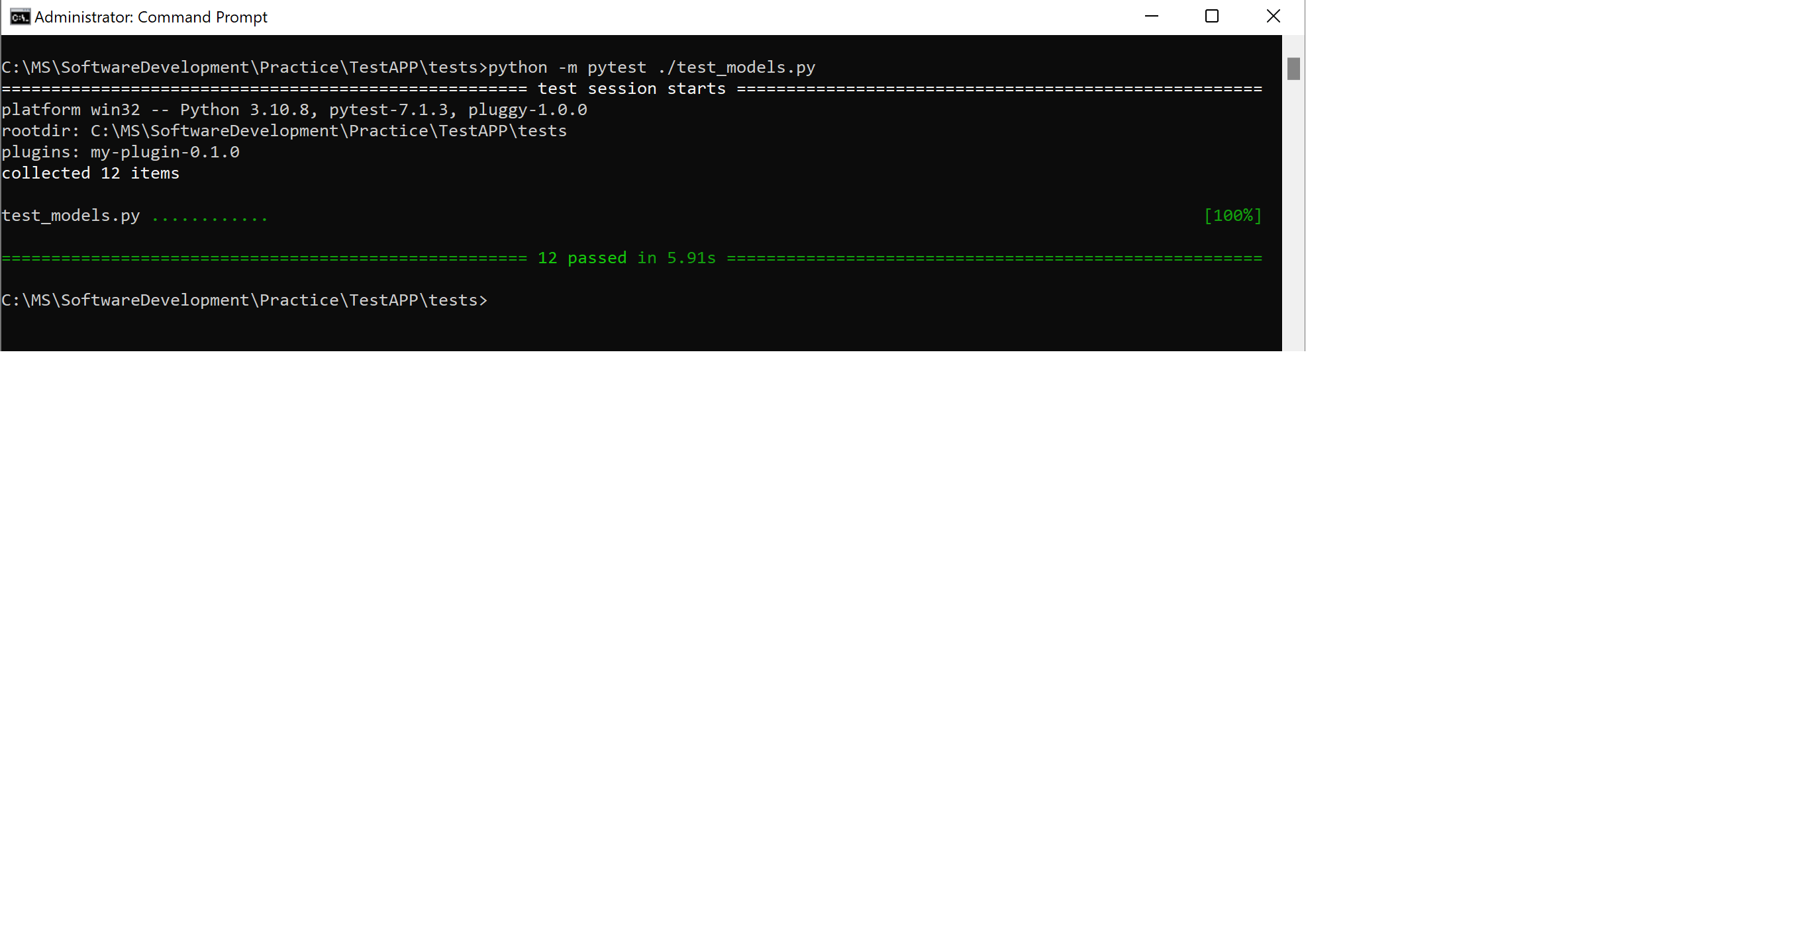
Testing

Slide 22
What's left? Milestone 2
5)
Story 7)
Admin user wants to be able to login into admin dashboard. In this dashboard admin user can configure the categories and subcategories information displayed in "YELP Search" widget.
Story 8)
Admin user shall be able to search most frequently entered categories and subcategories by user to better understand how users are interacting with the app
Notes:
User story 7 = Administrator configured application – Application reflects database – administrator has flexibility to manage / change yelp API categories
User story 8 = database of recorded search entries by Users, whenever admin logins into application they should be able to query certain search patterns
Database Admins will be able to see this recorded information to analyze trends such as
Velocity of search patterns
Search Category preferences by season and holiday
Search Category preferences by time of day
User Search Categories Patterns

Slide 23
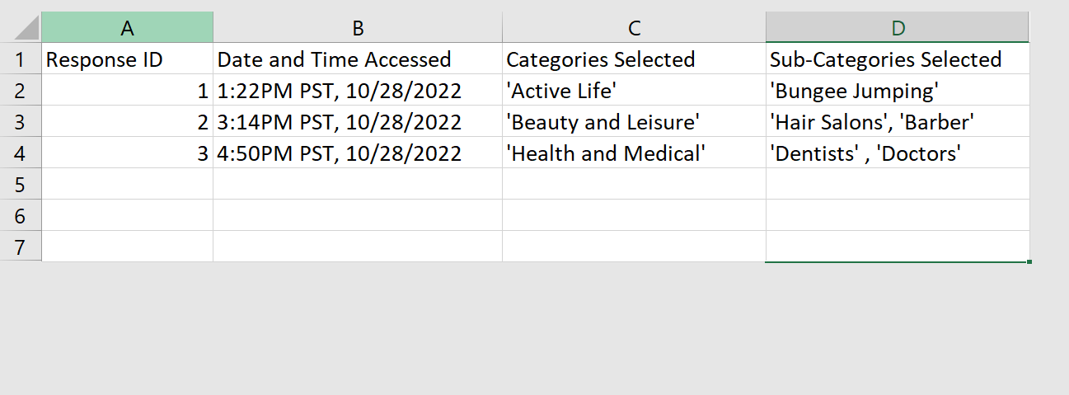
Database Model and SQLite Continued..
5)
Example: Entry Database
Notes:
By creating and maintaining a database for this application, we will be able to improve our application over time, and analyze trends and patterns for user searches
In SQLite DB, have 3 tables. Tables 1 & 2 reflect Admin Interface = User Story 7, Table 3 Reflects Search Entries = User Story 8

Slide 24
Questions?
Thanks for listening!

Slide 25
Sources
https://www.digitalocean.com/community/tutorials/how-and-when-to-use-sqlite
Pilone, D., and Miles, R. Head First Software Development. O’Reilly. 2008. 978-0- 596-52735-8. (Available at https://ccl.on.worldcat.org/oclc/213482767)
Lubanovic, B. Introducing Python. O’Reilly. 2015. 978-1-449-35936-2. (Available at https://ccl.on.worldcat.org/oclc/1127579360)
Okken, B. Python Testing with pytest. The Pragmatic Programmers. 2017. 978-1- 68050-240-4. (Available at https://ccl.on.worldcat.org/oclc/1014021663)
Notes:
Textbook chapters
Sql links
Pictures etc

